Slide 1
Implementing CBNAAT EQA PT round at sites level
Guidance document

Slide 2

PT Package dispatched from NTI to sites
Picture of the package from outside
Kit contains following components:
1a) Instruction Guide to CBNAAT Lab Technician
1b) Processing instruction (Job aid)
1c) 5 DTS panel tubes
1d) 5 Transfer pipettes
1e) 1 Reporting form
1f) 1 Feedback form

Slide 3
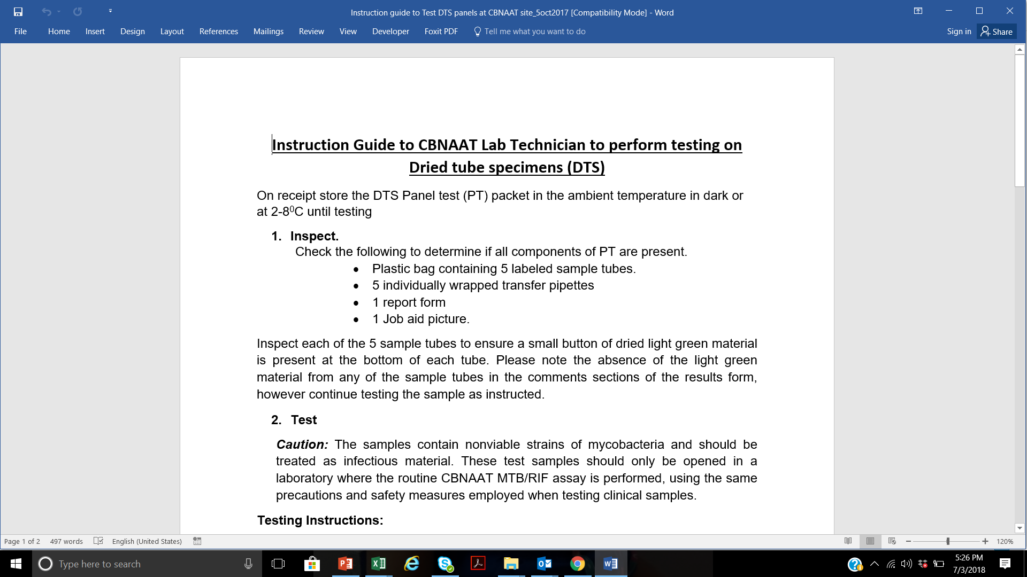
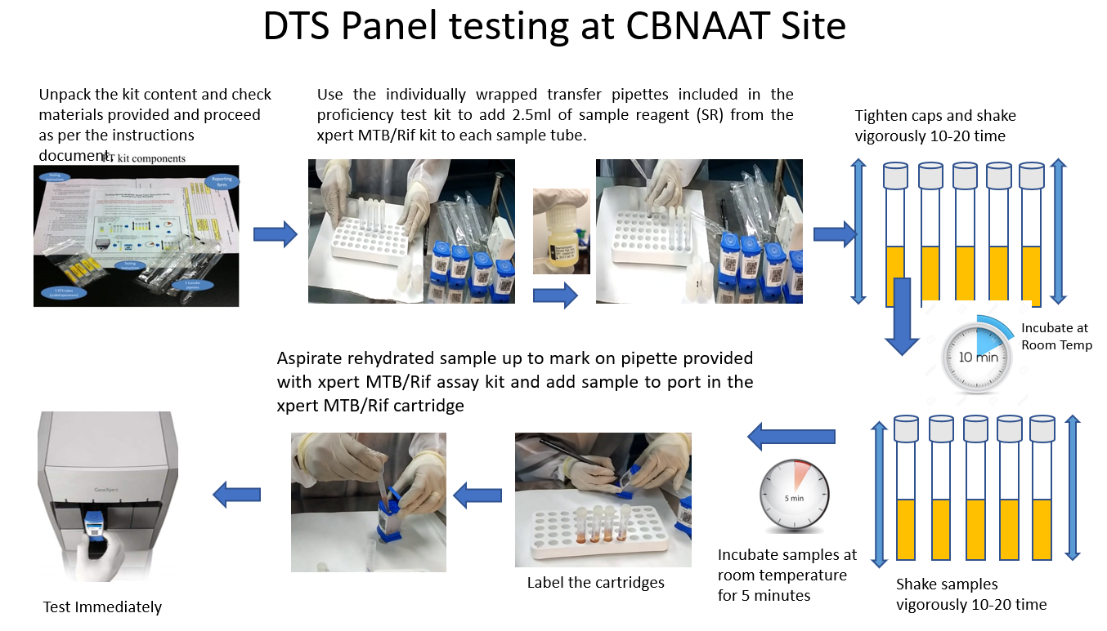
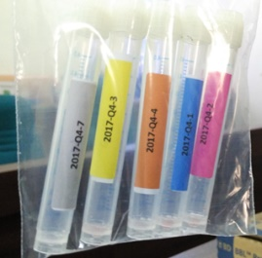
PT panel kits dispatched from NTI to CBNAAT sites
1a) Instruction Guide to CBNAAT Lab Technician (2 pager)
1b) Processing instruction (Job Aid)- 1 page
1c) 5 DTS panel tubes

Slide 4
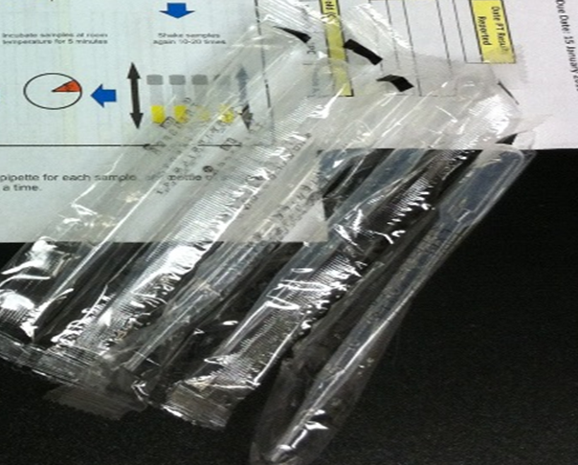
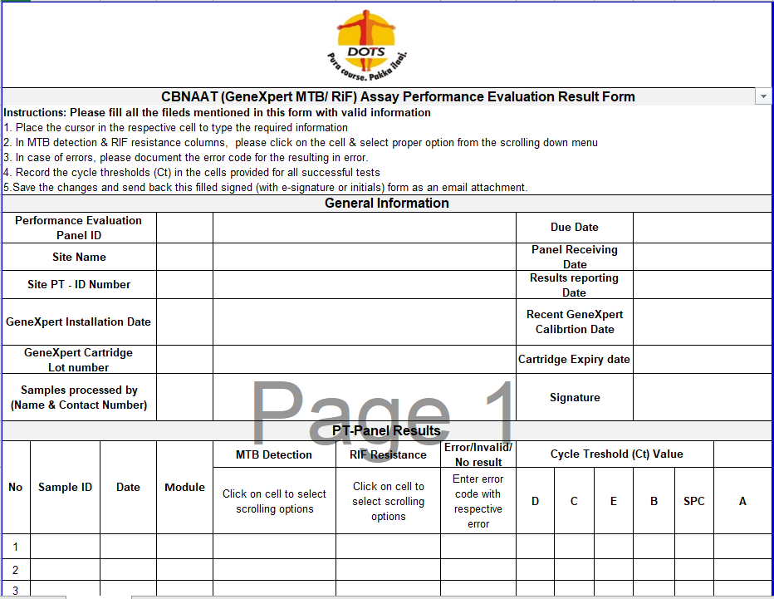
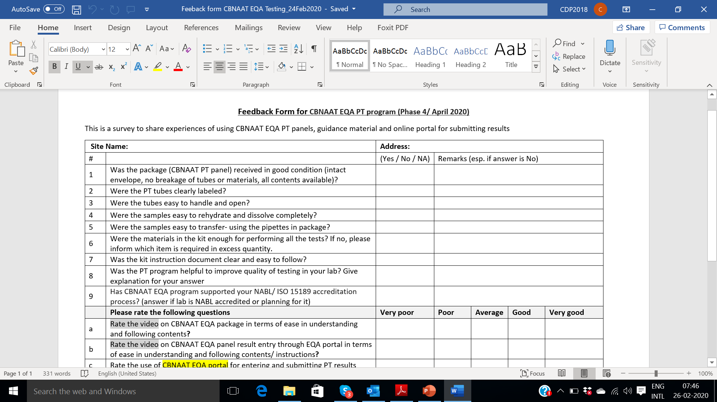
PT panel kits dispatched from NTI to sites
Continue ……………
1d) 5 Transfer pipettes
1e) Reporting form (1 page)
1f) Feed back form (1 page)

Slide 5
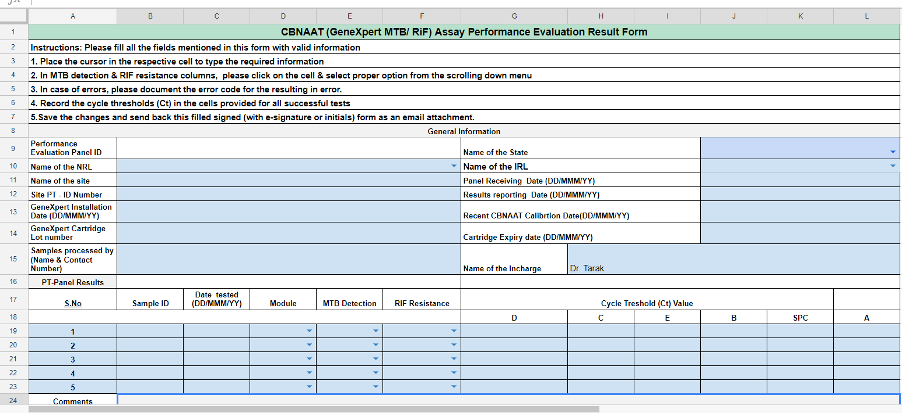
Data entry – Results Form…1
2018P3
1
2
First 6 letter from the Panel
3
4
5
6
7
8
9
10
11
12

Slide 6
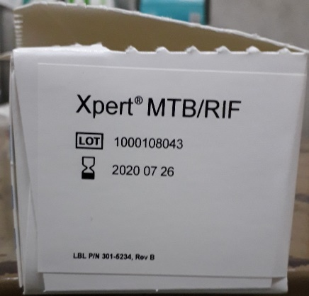
Data entry –Results Form cont….

Slide 7
DTS Panel testing at CBNAAT Site- DATA entry cont….

Slide 8
Open the genexper folder→ xpertcal→reports
DTS Panel testing at CBNAAT Site- DATA entry cont….
Steps to retrieve calibration information from the Xpert computer
OR

Slide 9
2. CBNAAT sites have to enter the results from “System generated test report in to Reporting form” and submit PT result to IRL in given formats below within 3 working days from the data of receiving.
  2a) System generated test report
  2b) Reporting form
2a) System generated test report (pdf)
2b) Reporting form

Slide 10
IRL has to verify the data which was submitted by each CBNAAT site by comparing between System generate test report (PDF) and Reporting form
System generate test report (pdf)
Reporting form

Slide 11
For Guidance please refer below link which contains Video of CBNAAT EQA implementation
Link…………………..

Slide 12
Thank You

